Slide 1
F
I
R
S
T
C
O
R
N
A
N
I
T
H
I
S
11.1-16
A free CD of this message will be available following the service
It will also be available for podcast later this week at calvaryokc.com

Slide 2
Imitate - mimētēs – mimic
O
A
N
S
1.1-16
I
I
F
I
R
S
T
C
R
N
T
H

Slide 3
Question Authority
Ask me anything
O
A
N
S
1.1-16
I
I
F
I
R
S
T
C
R
N
T
H

Slide 4
Mark 7.9, 13 - ⁹ He said to them, “All too well you reject the commandment of God, that you may keep your tradition. ¹³ making the word of God of no effect through your tradition which you have handed down.”
O
A
N
S
1.1-16
I
I
F
I
R
S
T
C
R
N
T
H

Slide 5
Mark Twain - “The less there is to justify a traditional custom, the harder it is to get rid of it.”
O
A
N
S
1.1-16
I
I
F
I
R
S
T
C
R
N
T
H

Slide 6
What submission is not:
What submission is:
1. Being a doormat
1. An Attitude
2. An Action
2. Voluntary attitude of giving in, cooperating, assuming responsibility, and carrying a burden
O
A
N
S
1.1-16
I
I
F
I
R
S
T
C
R
N
T
H

Slide 7
What submission is not:
What submission is:
3. Obedience
3. Phil. 2:3 - Let nothing be done through selfish ambition or conceit, but in lowliness of mind let each esteem others better than himself.
O
A
N
S
1.1-16
I
I
F
I
R
S
T
C
R
N
T
H

Slide 8
What submission is not:
What submission is:
4. Manipula-tion
4. Trusting God (1 Pet. 2:21-24)
O
A
N
S
1.1-16
I
I
F
I
R
S
T
C
R
N
T
H

Slide 9
1 Pet. 2:21-24 - ²¹ For to this you were called, because Christ also suffered for us, leaving us an example, that you should follow His steps:
²² “Who committed no sin,
Nor was deceit found in His mouth”;
²³ who, when He was reviled, did not revile in return;
O
A
N
S
1.1-16
I
I
F
I
R
S
T
C
R
N
T
H

Slide 10
when He suffered, He did not threaten, but committed Himself to Him who judges righteously; ²⁴ who Himself bore our sins in His own body on the tree, that we, having died to sins, might live for righteousness — by whose stripes you were healed.
O
A
N
S
1.1-16
I
I
F
I
R
S
T
C
R
N
T
H

Slide 11
John 5.18 - Therefore the Jews sought all the more to kill Him, because He not only broke the Sabbath, but also said that God was His Father, making Himself equal with God.
O
A
N
S
1.1-16
I
I
F
I
R
S
T
C
R
N
T
H

Slide 12
X
X
O
A
N
S
1.1-16
I
I
F
I
R
S
T
C
R
N
T
H

Slide 13
Ray Stedman - “It is significant to note that both men and women were free to exercise ministry. Both could pray and prophesy. Either a woman or a man could do that, but it was very important how they did
O
A
N
S
1.1-16
I
I
F
I
R
S
T
C
R
N
T
H

Slide 14
it. That is the emphasis this passage makes. They must do it in two different ways, the male as a man; the woman as a woman. That is the central emphasis of this text.”
O
A
N
S
1.1-16
I
I
F
I
R
S
T
C
R
N
T
H

Slide 15
Gen. 2:18 - It is not good that man should be alone; I will make him a helper comparable to him.
KJV, help meet; Not help-meet
Literally, A “completing counterpart”
O
A
N
S
1.1-16
I
I
F
I
R
S
T
C
R
N
T
H

Slide 16
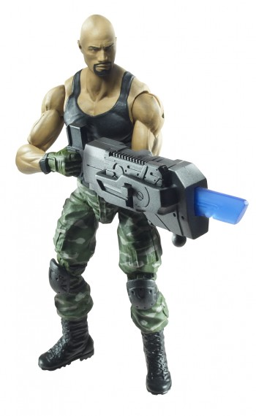
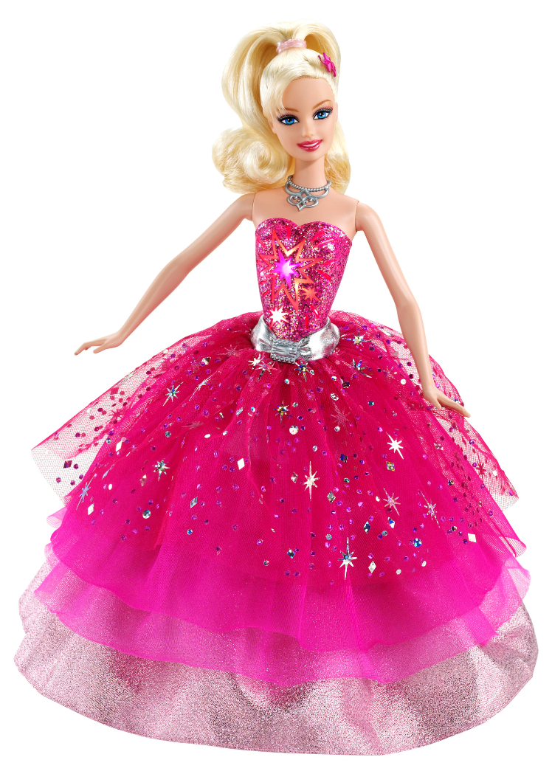
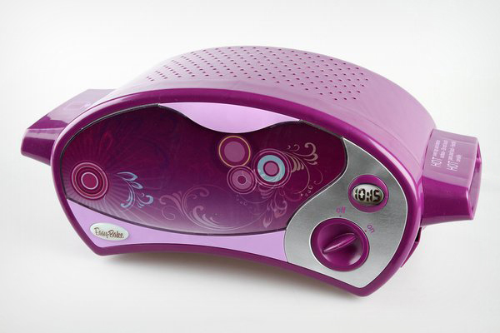
Barbie
G I joe
Easy bake oven
O
A
N
S
1.1-16
I
I
F
I
R
S
T
C
R
N
T
H

Slide 17
Alan Redpath - “A man who can only rule by stamping his foot had better remain single. But a man who knows how to govern his house by the love of the Lord, through sacrificial submission to the Lord, is the man who is going to make a perfect husband …
O
A
N
S
1.1-16
I
I
F
I
R
S
T
C
R
N
T
H

Slide 18
… The woman who cannot submit to an authority like that had better remain single.”
O
A
N
S
1.1-16
I
I
F
I
R
S
T
C
R
N
T
H

Slide 19
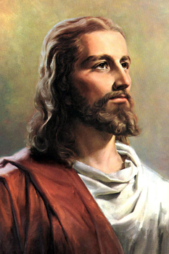
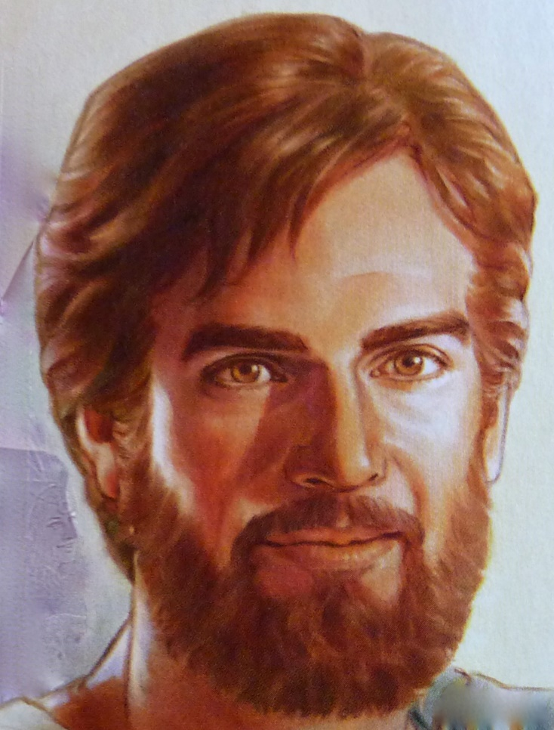
Pre-60s Jesus vs. Post-60s Jesus
O
A
N
S
1.1-16
I
I
F
I
R
S
T
C
R
N
T
H

Slide 20
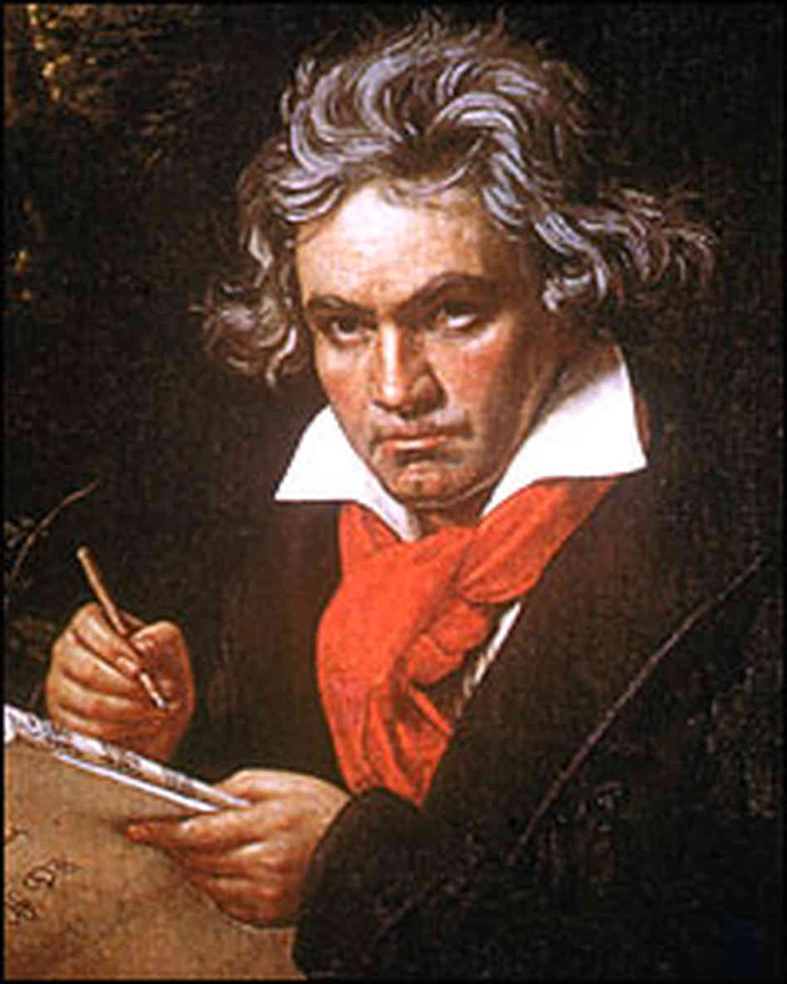
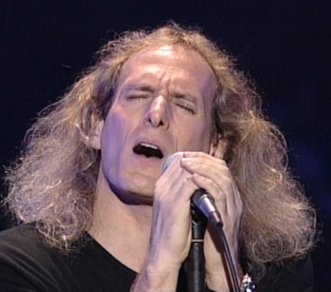
Long-haired music vs. Long-Haired music
O
A
N
S
1.1-16
I
I
F
I
R
S
T
C
R
N
T
H

Slide 21
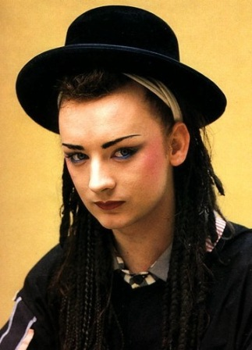
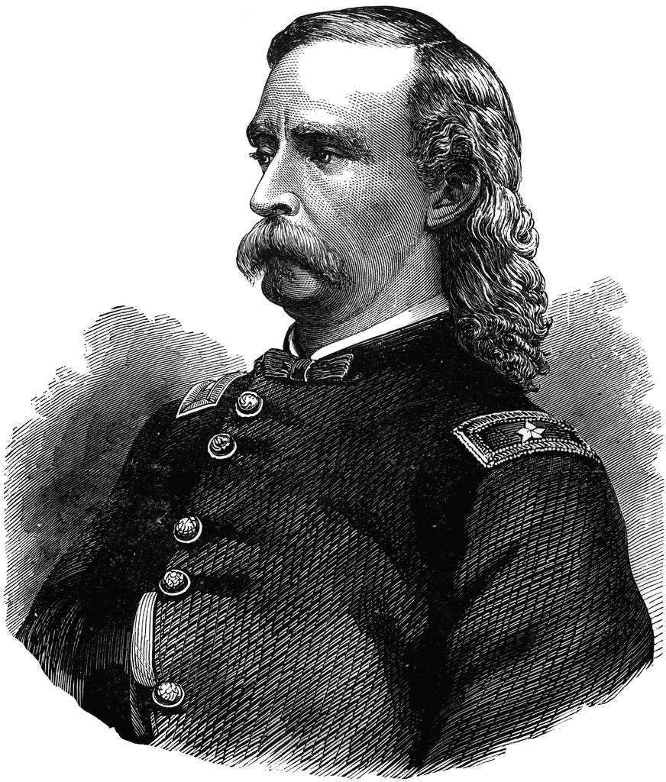
Boy George vs. George Armstrong Custer
O
A
N
S
1.1-16
I
I
F
I
R
S
T
C
R
N
T
H

Slide 22
For a covering - anti – instead of
Deut. 22.5 - A woman shall not wear anything that pertains to a man, nor shall a man put on a woman's garment, for all who do so are an abomination to the Lord your God.
O
A
N
S
1.1-16
I
I
F
I
R
S
T
C
R
N
T
H

Slide 23
Ray Stedman - “It has now become a question, not so much of women wearing hats in church, but of whether they are going to wear the pants at home.”
O
A
N
S
1.1-16
I
I
F
I
R
S
T
C
R
N
T
H

Slide 24
Contentious - philoneikos = philos + nikē (a lover of victory)
O
A
N
S
1.1-16
I
I
F
I
R
S
T
C
R
N
T
H

Slide 25
Warren Wiersbe - “How does this matter of ‘wearing hats’ and ‘wearing short hair’ apply to us today? While we do not have all of the same circumstances that Paul had to deal with in Corinth, we must admit that a woman or a man
O
A
N
S
1.1-16
I
I
F
I
R
S
T
C
R
N
T
H

Slide 26
out of place is always a hindrance to the work of God. There ought to be modesty in the local church, both in dress and action. We dare not conform to the world, lest we lose our testimony.”
O
A
N
S
1.1-16
I
I
F
I
R
S
T
C
R
N
T
H

